Slide 1
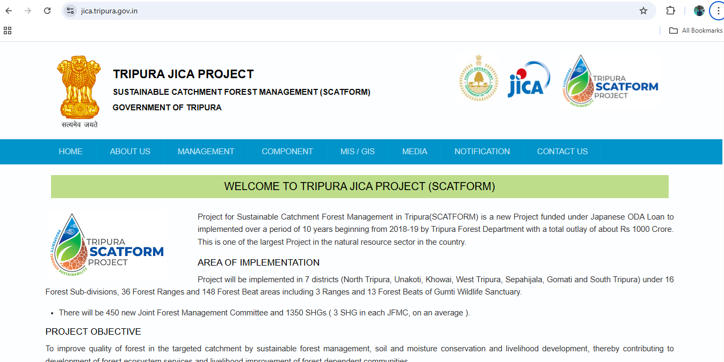
New section will be added
RTI
Sustainable Forest Management
Soil and Moisture Conservation
Institutional Strengthening
Livelihood Development
Ecotourism Development
Office Order/Circular
Tenders
Introduction
Vision & Mission
Who is Who
Committee
Project Management Unit (PMU)
District Management Unit (DMU)
Sub-Divisional Management Unit (SDMU)
Range Management Unit (RMU)
MIS
GIS
Social Media
Publications
Downloads
Reports
Gallery
Spotlight
Plantation
Nursery
Fishery
Livestock
NTFP & Non- NTFP Based Product
Agroforestry
High Power Sterring Committee (HPSC)
Governing Body (GB)
Executive Committee (EC)
Procurement Committee (PC)
Grievances Redressal Committee
Sexual Harassment Committee
SMC Structures
Water Quality Monitoring
Forestry Integrated Geospatial Solution (FIGS)
SCAT-AMS
Capacity Building Activities
Construction
Cost Breakdown
Project Duration
JFMC(s) / EDC(s)
SHG(s) / JLG(s)

Slide 2
HOME
Header Banner
Welcome Message
About JICA
Spotlight
Pictorial Glimpses
Facts and Figures
Logos
Latest Newsletter
Latest Media Coverage
Latest Tender
Recent Tweets
YouTube Twitter and Facebook*
Important Links

Slide 3
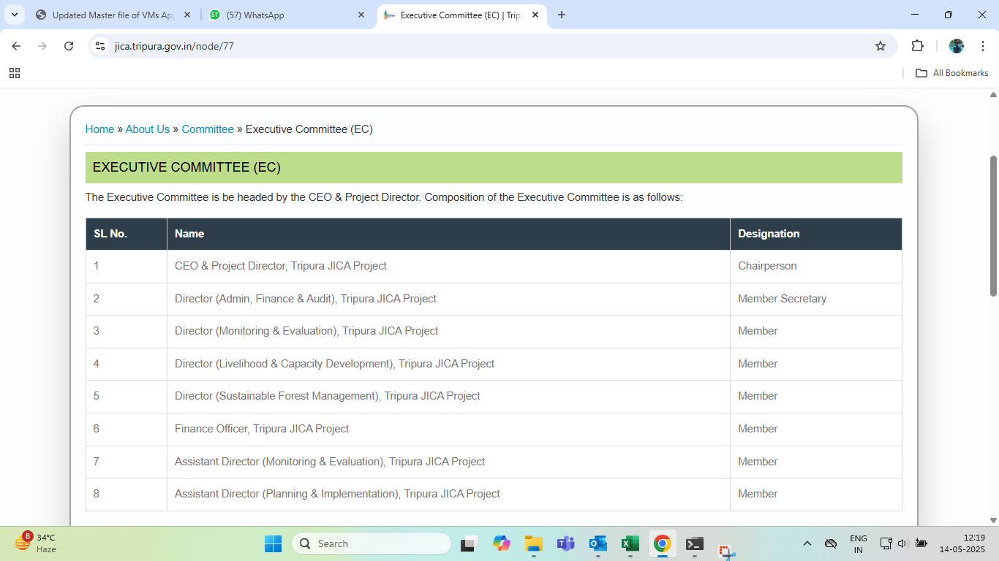
About us
INTRODUCTION
VISION & MISSION
High Power Steering Committee (HPSC)
WHO IS WHO
Governing Body (GB)
COMMITTEE
Executive Committee (EC)
Procurement Committee (PC)
Grievances Redressal Committee
Content will be updated . It will be a combination of existing content and some new information. Add name of Person, Contact Number & Photos along with Designation and Position in Committee.

Slide 4
Management
Project Management Unit (PMU)
District Management Unit (DMU
Sub-Divisional Management Unit (SDMU)
Range Management Unit (RMU)
Content will be same as the previous website. Employee Information will be updated

Slide 5
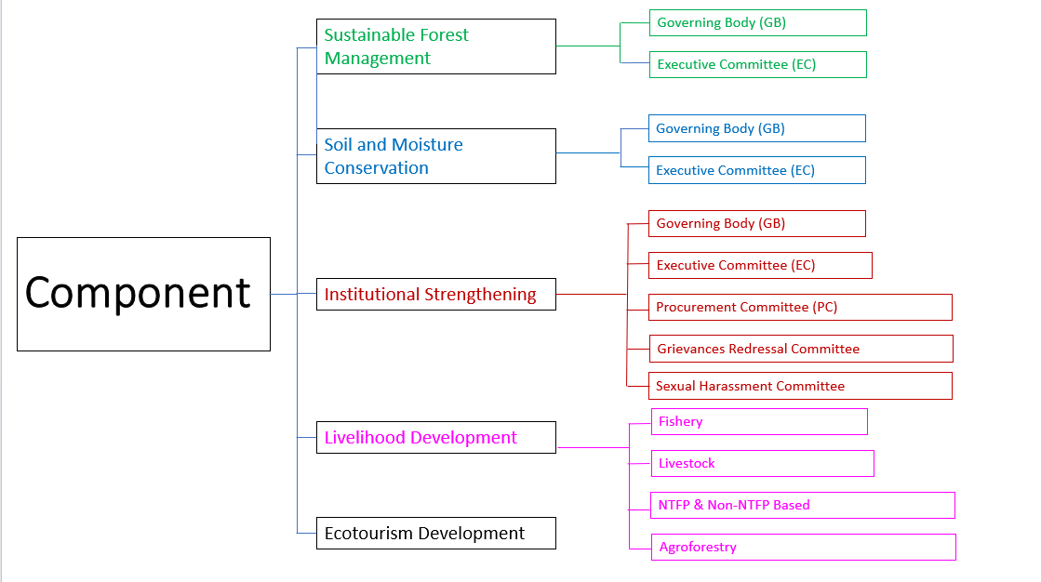
Content will be updated and statistical dataset will be provided in form of Graphs & Pie-charts . Hyperlink of image location will be given . All the images will be stored in a Gallery Page according to headings

Slide 6
MIS/GIS
Cost Breakdown
Project Duration
MIS
JFMC(s) / EDC(s)
GIS
SHG(s) / JLG(s)
For MIS, content will be same as previous website
For GIS, Maps will be updated and multiple map will be uploaded will can be changed by selection

Slide 7
Media
Social Media
Publications
Downloads
Reports
Gallery
Spotlight
Social Media- Two different segments will be there. YouTube video and Facebook & Twitter Posts.
Publications- Two different segments will be there. Newsletters and Media Coverage.
Downloads- Pdf files, apk links etc related to department will be available for download.
Reports- Pdf files related to department will be available for download. We will make few category and files will be available as per category
Gallery- Two different segments will be available i.e. photos and videos. Based on components , categories will be defined.
Spotlight- Information on events etc which needs to be highlighted will be available.
NOTE- IN THE MEDIA SECTION, INFORMATION WILL BE UPDATED FROM TIME TO TIME, HENCE A FRONT-END INTERFACE WILL BE PROVIDED FROM WHERE ALL THE INFORMATION'S WILL BE UPDATED.

Slide 8
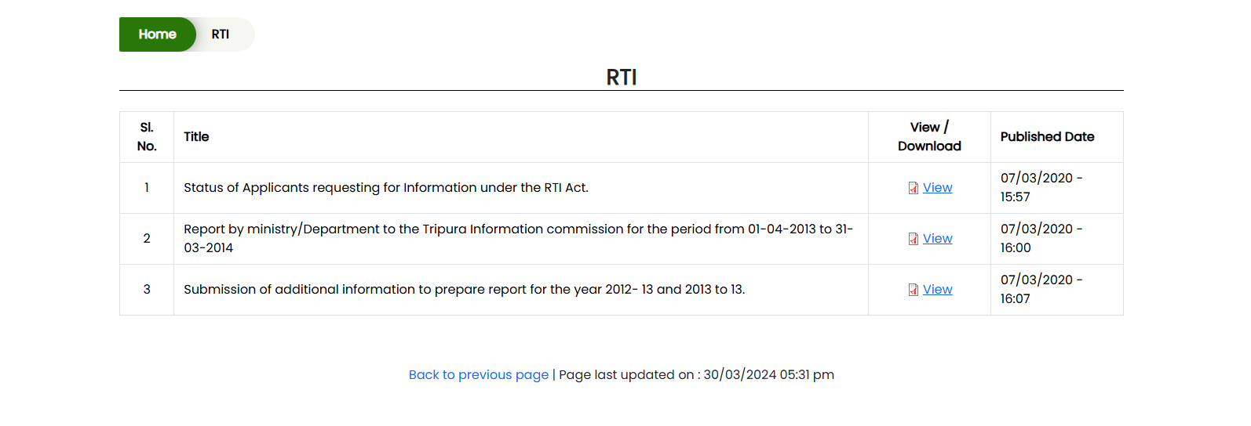
RTI
NOTE- IN THE SECTION, INFORMATION RELATED TO RTI WILL BE AVAILAIBLE. HENCE A FRONT-END INTERFACE WILL BE PROVIDED FROM WHERE ALL THE INFORMATION'S WILL BE UPDATED.

Slide 9
NOTIFICATION
OFFICE ORDER/CIRCULAR
TENDERS
NOTE- IN THE SECTION, INFORMATION WILL BE UPDATED FROM TIME TO TIME, HENCE A FRONT-END INTERFACE WILL BE PROVIDED FROM WHERE ALL THE INFORMATION'S WILL BE UPDATED.
TENDERS WILL BE DIVIDED INTO THREE CATEGORIES-Active Tenders, tenders by closing date, Corrigendum, Result of tenders. TENDER VISIBILITY WILL BE SORTED BY DATE

Slide 10
CONTACT US
Content will be same as previous website; a new enquiry form will be designed .
Name-
Age-
Gender-
Mobile Number-
Email id-
Aadhar Number-
Query-

Slide 11
Component
Sustainable Forest Management
Governing Body (GB)
Executive Committee (EC)
Governing Body (GB)
Soil and Moisture Conservation
Executive Committee (EC)
Governing Body (GB)
Executive Committee (EC)
Institutional Strengthening
Procurement Committee (PC)
Grievances Redressal Committee
Sexual Harassment Committee
Fishery
Livelihood Development
Livestock
NTFP & Non-NTFP Based
Ecotourism Development
Agroforestry

